Slide 1
Classification and Regression Trees (CART) and Causal Trees
Susan Athey, Stanford University
Machine Learning and Causal Inference

Slide 2
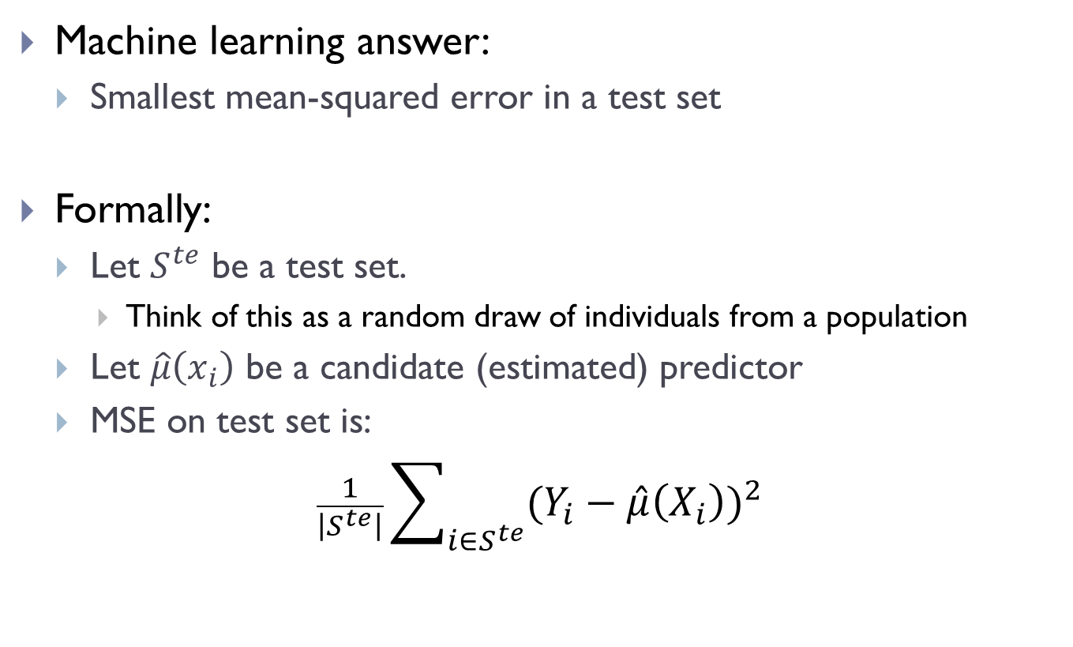
What is the goal of prediction?
Machine learning answer:
Smallest mean-squared error in a test set
Formally:
Let $S^{te}$ be a test set.
Think of this as a random draw of individuals from a population
Let $\hat{μ}\left(x_{i}\right)$ be a candidate (estimated) predictor
MSE on test set is:
$$\frac{1}{\left|S^{te}\right|}\sum_{i∈S^{te}}{{(Y_{i}−\hat{μ}\left(X_{i}\right))}^{2}}$$

Slide 3
Regression Trees
Simple method for prediction
Partition data into subsets by covariates
Predict using average within each subset
Why are regression trees popular?
Easy to understand and explain
Businesses often need “segments”
Software assigns different algorithms to different segments
Can completely describe the algorithm and interpretation

Slide 4
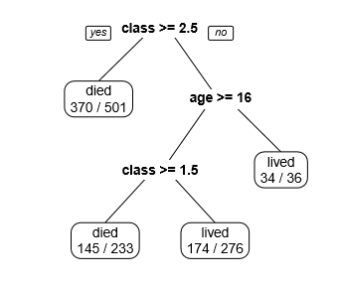
Example: Who survived the Titantic?

Slide 5
Regression Trees for Prediction
Data
Outcomes Y_{i}, attributes X_{i}.
Support of X_{i} is X.
Have training sample with independent obs.
Want to predict on new sample
Build a “tree”:
Partition of X into “leaves” X _{j}
Predict Y conditional on realization of X in each region X _{j} using the sample mean in that region
Go through variables and leaves and decide whether and where to split leaves (creating a finer partition) using in-sample goodness of fit criterion
Select tree complexity using cross-validation based on prediction quality

Slide 6
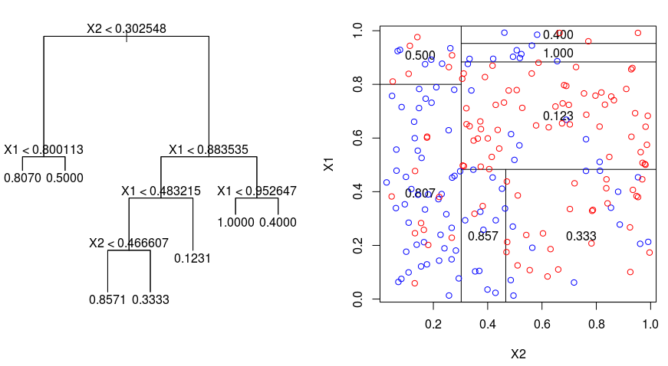
Regression Trees for Prediction
Outcome: Binary (Y in {0,1})
Two covariates
Goal: Predict Y as a function of X
“Classify” units as a function of X according to whether they are more likely to have Y=0 or Y=1

Slide 7
Regression Trees for Prediction
(1) Tree-building: Use algorithm to partition data according to covariates (adaptive: do this based on the difference in mean outcomes in different potential leaves.)
(II) Estimation/prediction: calculate mean outcomes in each leaf
(III) Use cross-validation to select tree complexity penalty

Slide 8
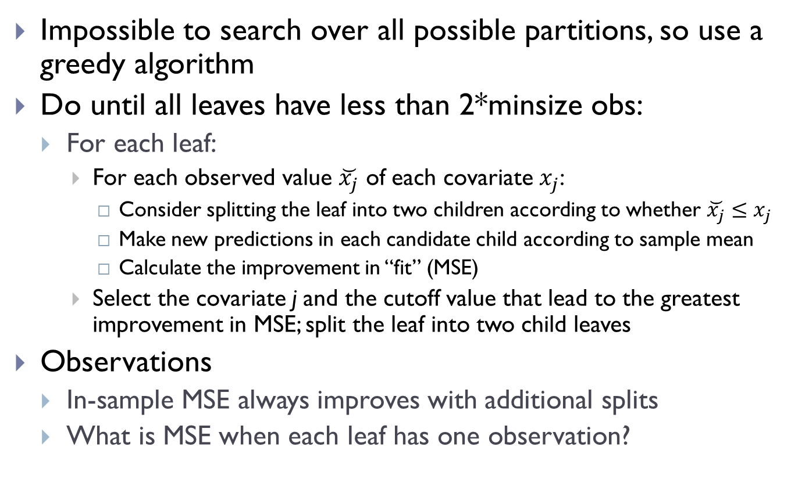
Tree Building Details
Impossible to search over all possible partitions, so use a greedy algorithm
Do until all leaves have less than 2*minsize obs:
For each leaf:
For each observed value $\breve{x_{j}}$ of each covariate $x_{j}$:
Consider splitting the leaf into two children according to whether $\breve{x_{j}}≤x_{j}$
Make new predictions in each candidate child according to sample mean
Calculate the improvement in “fit” (MSE)
Select the covariate j and the cutoff value that lead to the greatest improvement in MSE; split the leaf into two child leaves
Observations
In-sample MSE always improves with additional splits
What is MSE when each leaf has one observation?

Slide 9
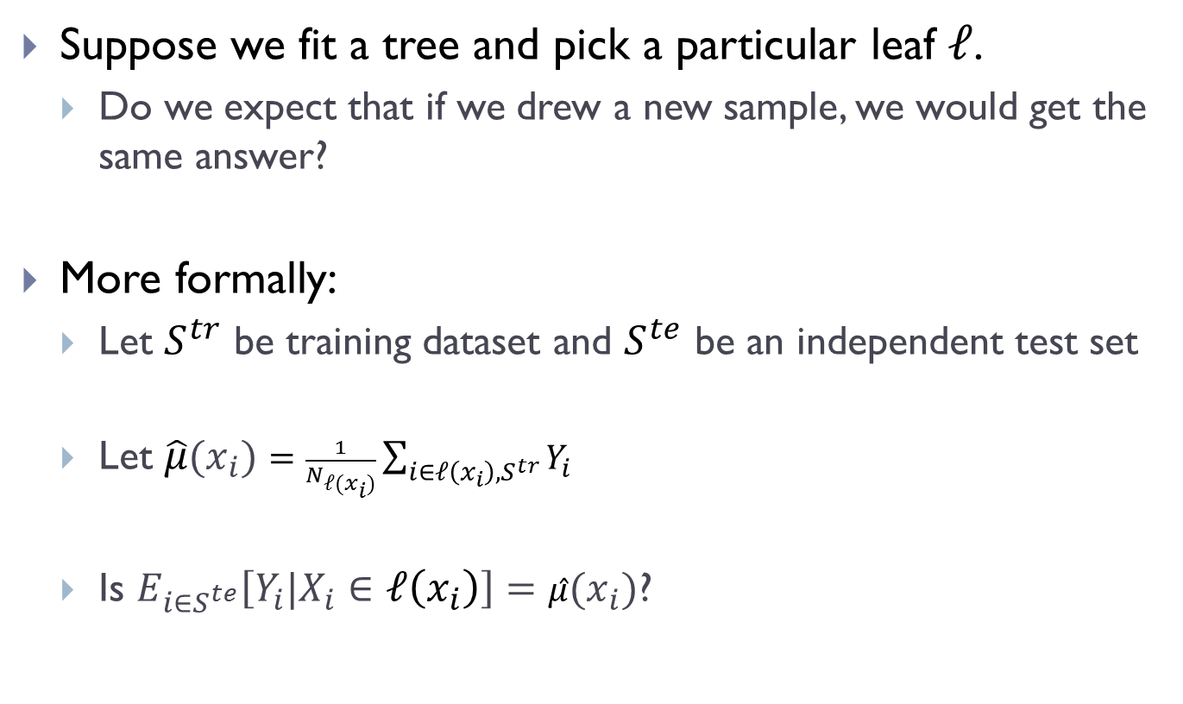
Problem: Tree has been “over-fitted”
Suppose we fit a tree and pick a particular leaf $ℓ$.
Do we expect that if we drew a new sample, we would get the same answer?
More formally:
Let $S^{tr}$ be training dataset and $S^{te}$ be an independent test set
Let $\hat{μ}(x_{i})=\frac{1}{N_{ℓ(x_{i})}}\sum_{i∈ℓ\left(x_{i}\right), S^{tr}}{Y_{i}}$
Is $E_{{i∈S}^{te}}\left[Y_{i}|X_{i}∈ℓ\left(x_{i}\right)\right]=\hat{μ}(x_{i})$?

Slide 10
What are tradeoffs in tree depth?
First: note that in-sample MSE doesn’t guide you
It always increases with depth
Tradeoff as you grow tree deeper
More personalized predictions
More biased estimates

Slide 11
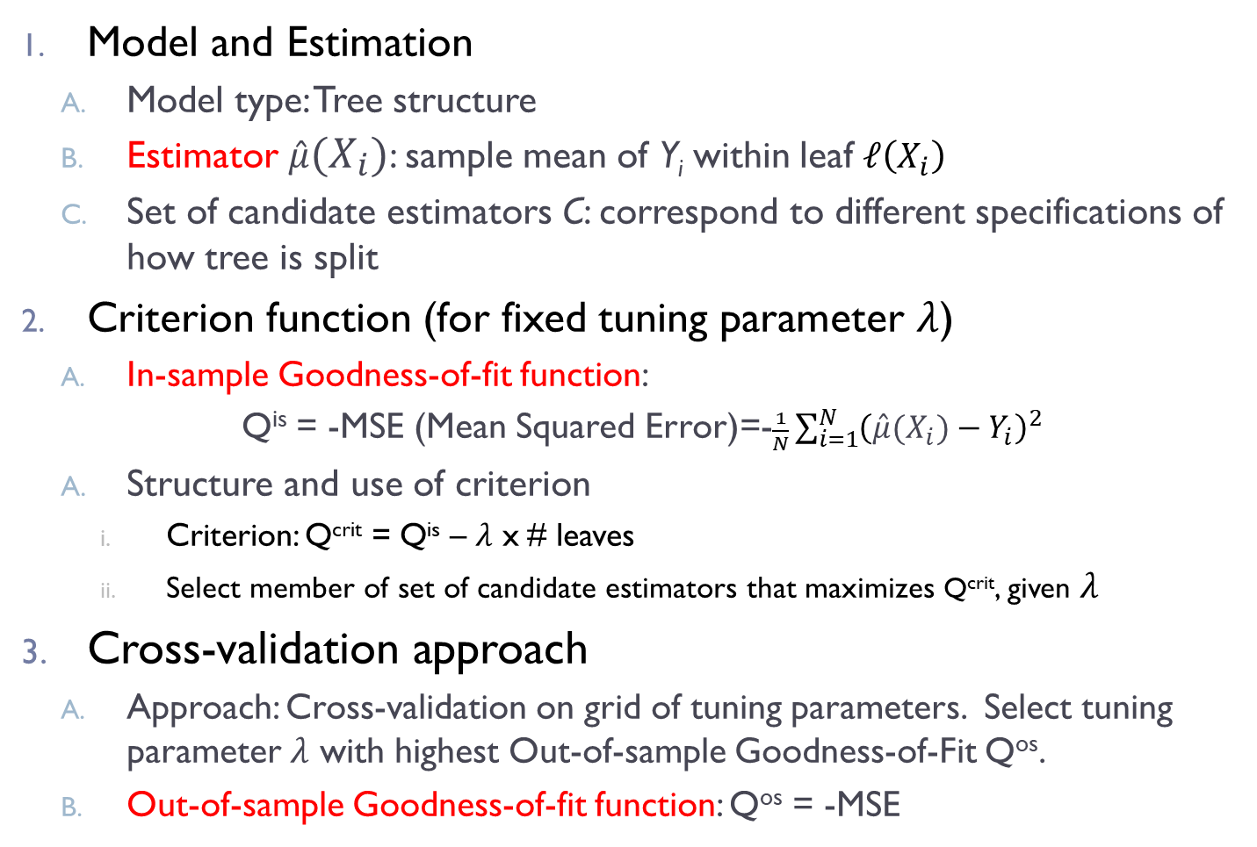
Regression Trees for Prediction: Components
Model and Estimation
Model type: Tree structure
Estimator $\hat{μ}(X_{i})$: sample mean of Y_{i} within leaf $ℓ\left(X_{i}\right)$
Set of candidate estimators C: correspond to different specifications of how tree is split
Criterion function (for fixed tuning parameter $λ$)
In-sample Goodness-of-fit function:
Q^{is} = -MSE (Mean Squared Error)=-$\frac{1}{N}\sum_{i=1}^{N}{{\left(\hat{μ}(X_{i})−Y_{i}\right)}^{2}}$
Structure and use of criterion
Criterion: Q^{crit} = Q^{is} – $λ$ x # leaves
Select member of set of candidate estimators that maximizes Q^{crit}, given $λ$
Cross-validation approach
Approach: Cross-validation on grid of tuning parameters. Select tuning parameter $λ$ with highest Out-of-sample Goodness-of-Fit Q^{os}.
Out-of-sample Goodness-of-fit function: Q^{os} = -MSE

Slide 12
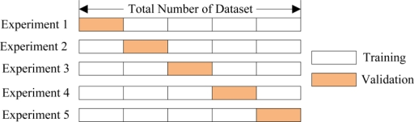
How Does Cross Validation Work?
CV-Tuning
CV-Training
Train
Tune
Tuning Set = 1/5 of Training Set

Slide 13
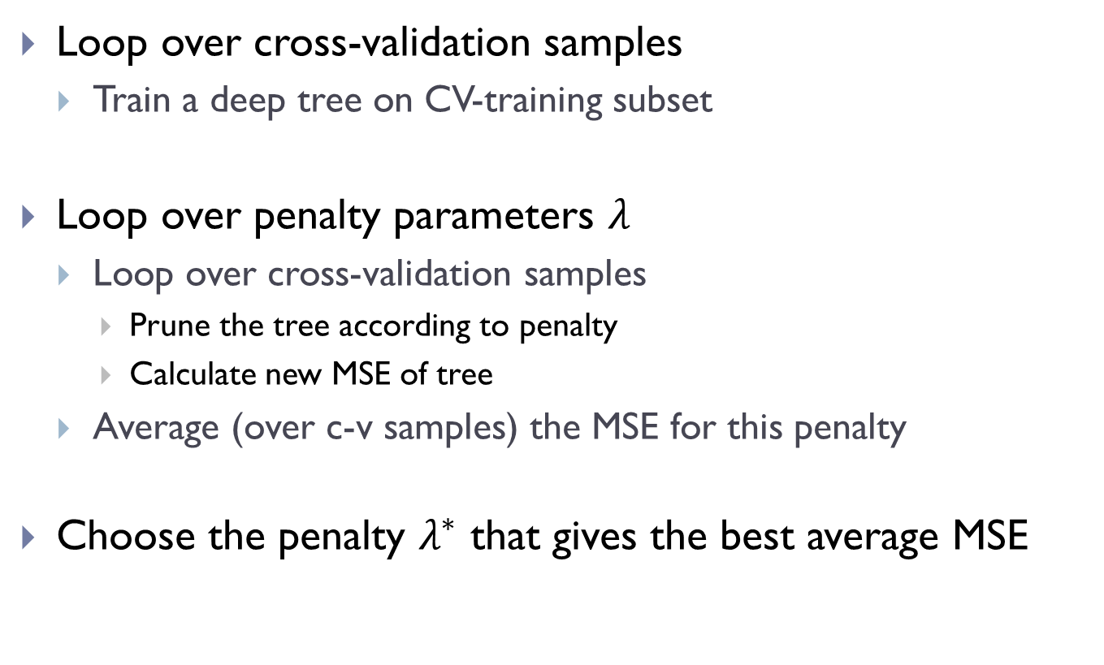
Cross-Validation Mechanics
Loop over cross-validation samples
Train a deep tree on CV-training subset
Loop over penalty parameters $λ$
Loop over cross-validation samples
Prune the tree according to penalty
Calculate new MSE of tree
Average (over c-v samples) the MSE for this penalty
Choose the penalty $λ^{∗}$ that gives the best average MSE

Slide 14
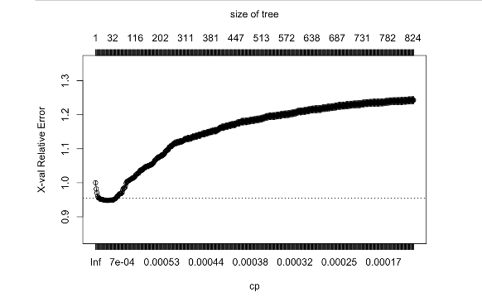
Choosing the penalty parameter

Slide 15
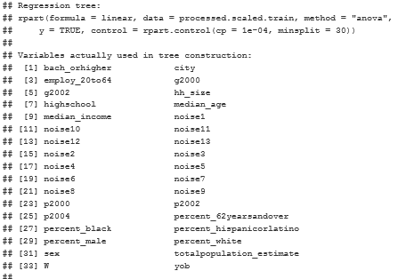
Some example code

Slide 16
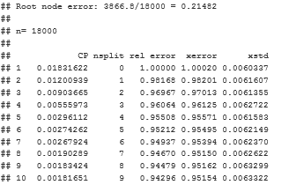
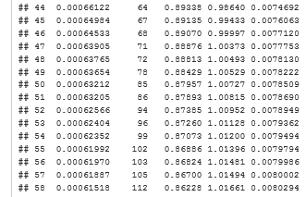

Slide 17
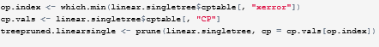
Pruning Code

Slide 18
A Basic Policy Problem
Every transfer program in the world must determine…
Who is eligible for the transfer
Typical goal of redistributive programs
Transfer to neediest
But identifying the neediest is easier said than done
Thanks to Sendhil Mullainathan for providing this worked out example….

Slide 19
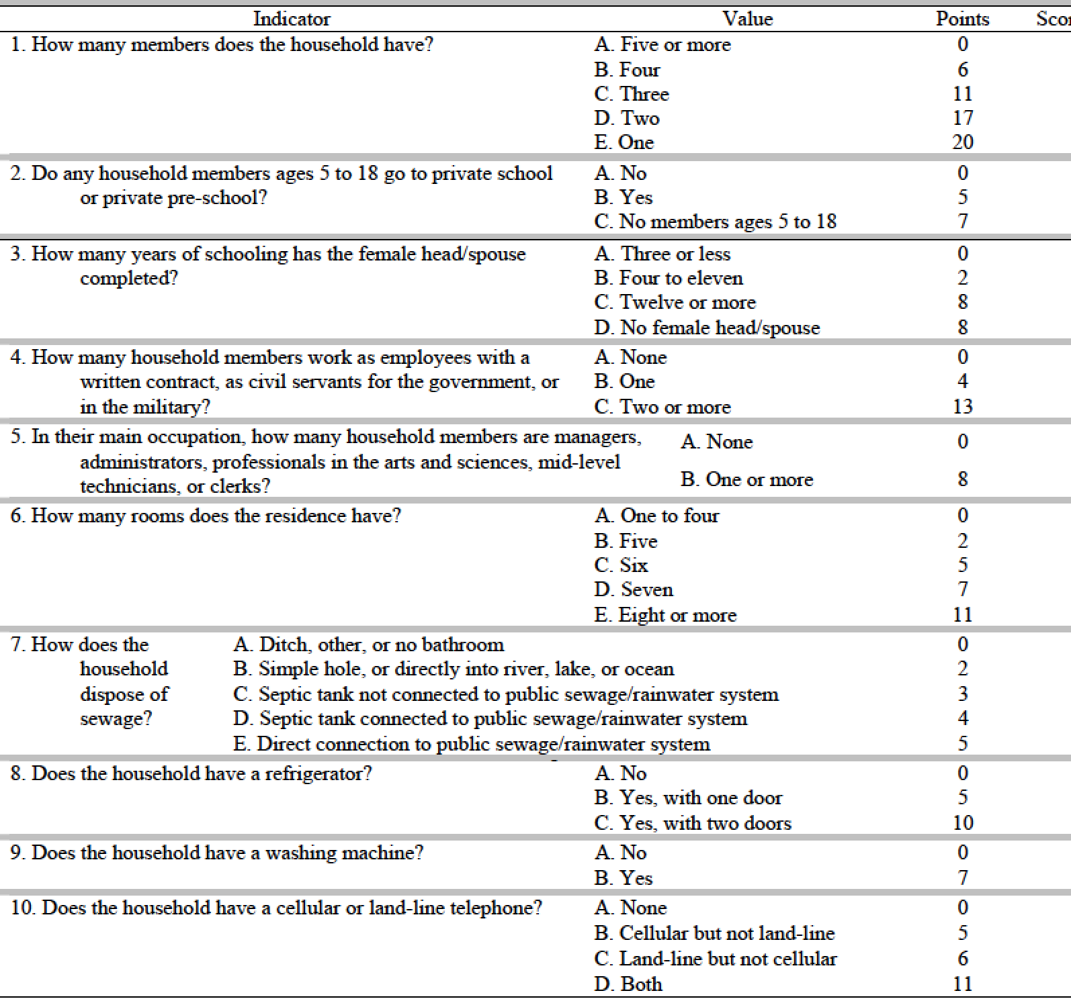
Typical Poverty Scorecard

Slide 20
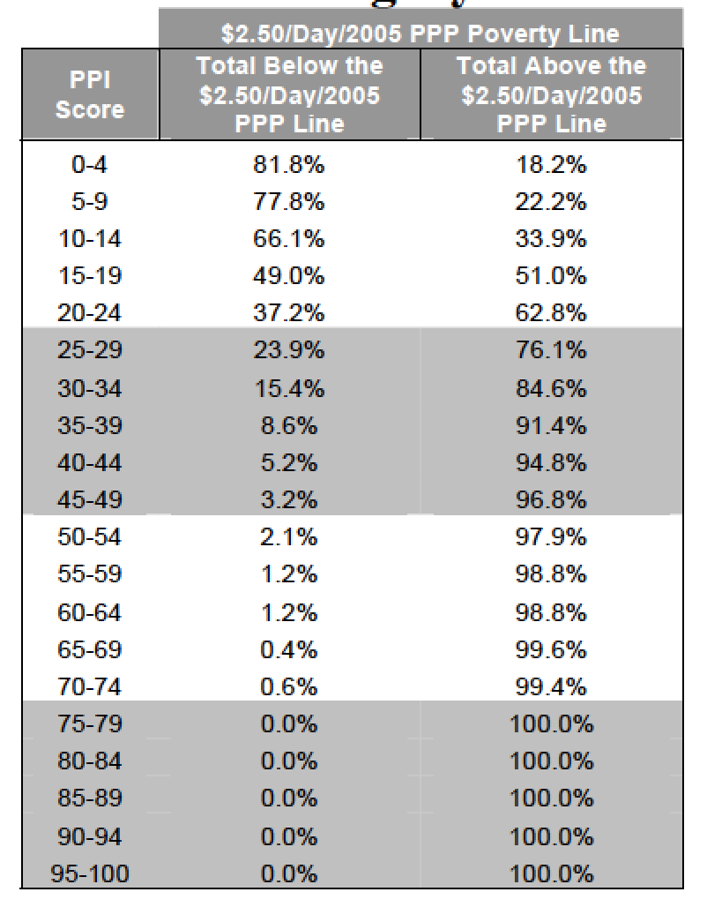

Slide 21
Can we do better?
This component of targeting is a pure prediction problem
We fundamentally care about getting best predictive accuracy
Let’s use this example to illustrate the mechanics of prediction

Slide 22
Brazilian Data
The data:
44,787 data points
53 variables
Not very wide?
Median
Annual consumption (in dollars): 3918
348.85 monthly income
6 percent below 1.90 poverty line
14 percent below the 3.10 poverty line

Slide 23
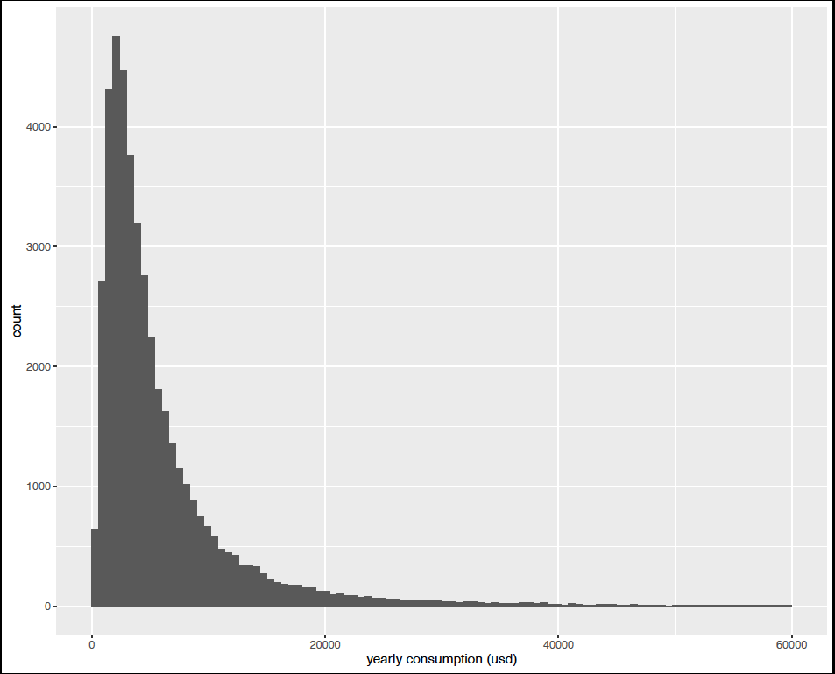
Consumption

Slide 24
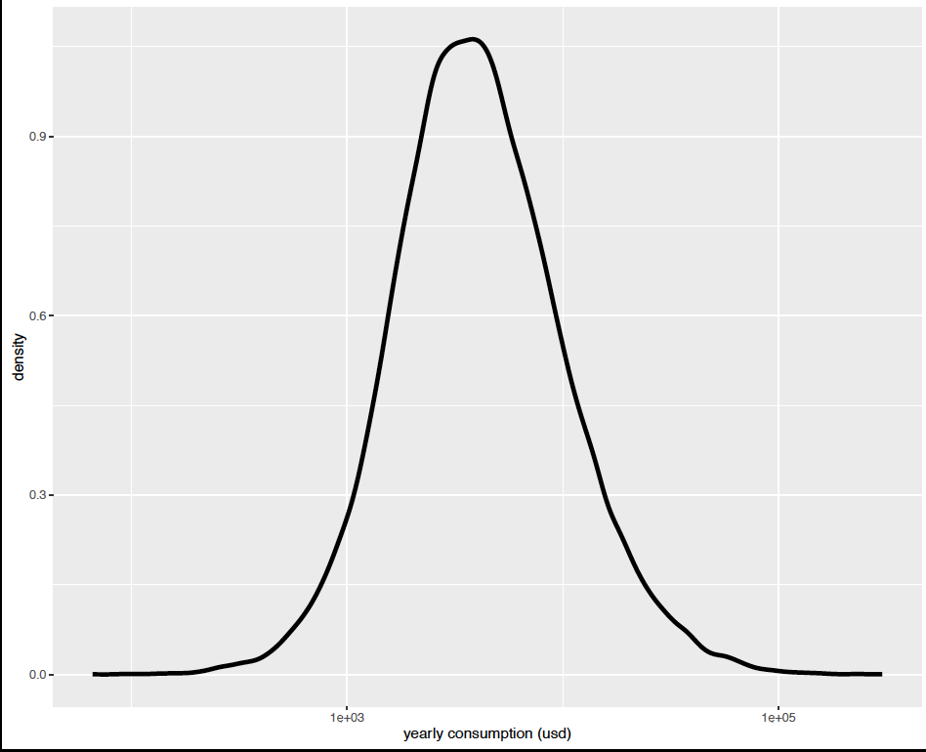
log (consumption)

Slide 25
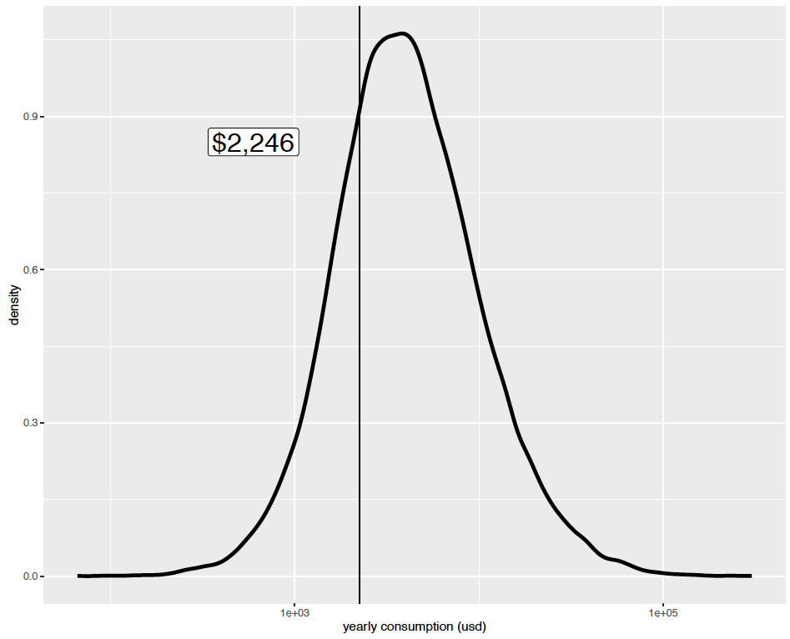
50th Percentile

Slide 26
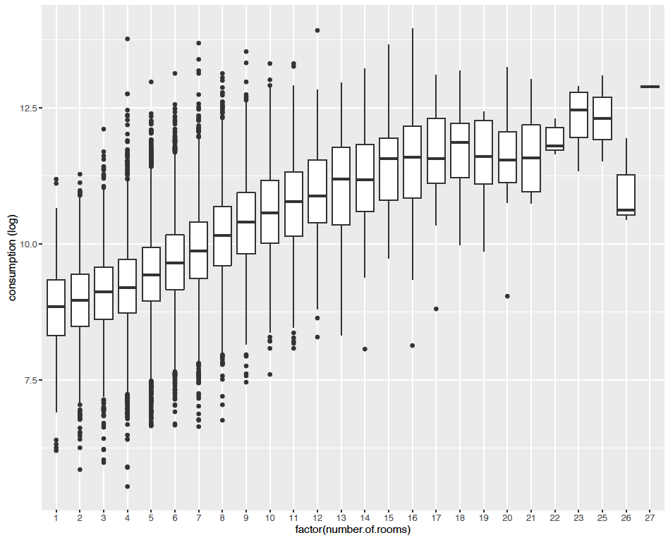

Slide 27
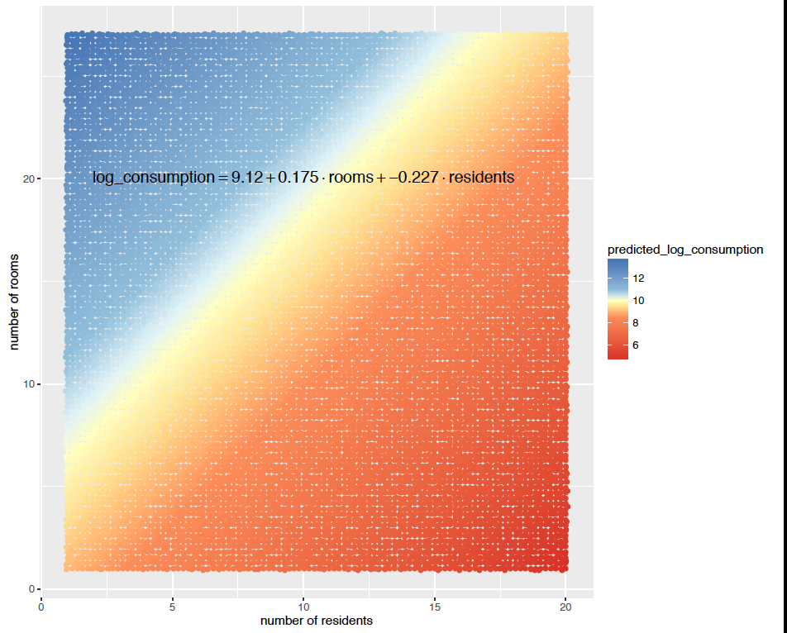

Slide 28
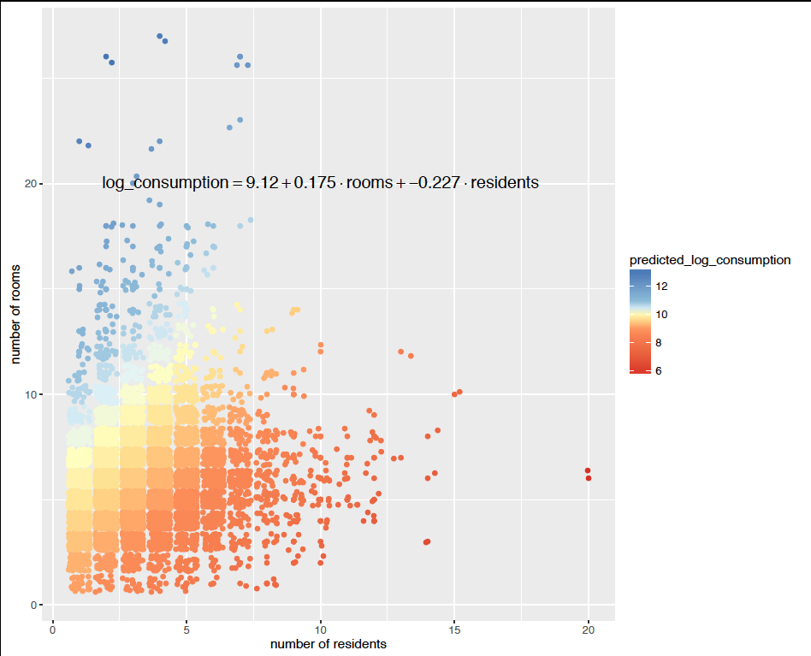

Slide 29
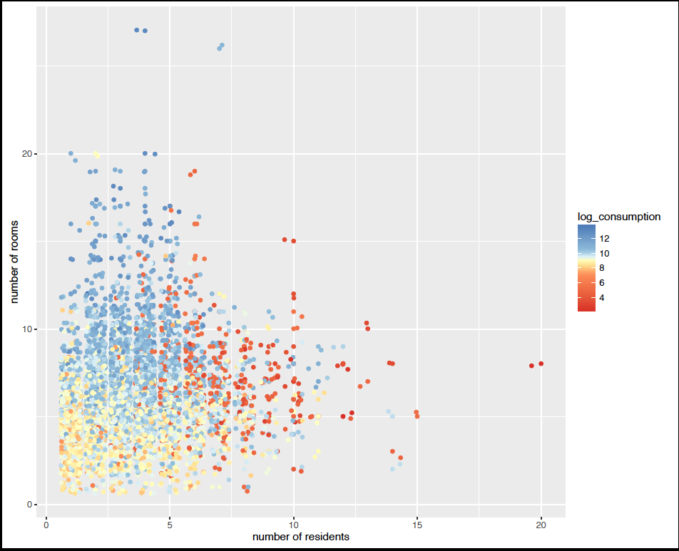

Slide 30
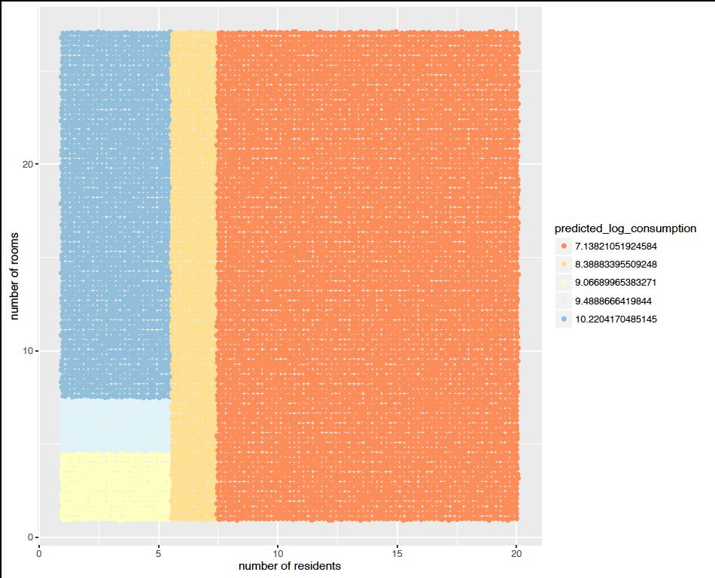
Two Variable Tree

Slide 32
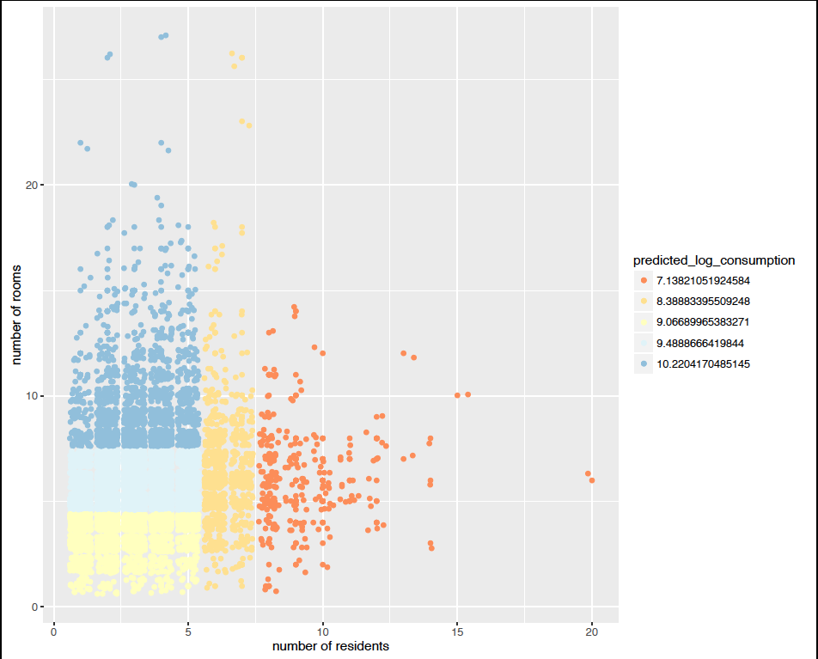

Slide 33
28,573 data points to Fit with
8061
8061
8061
8061
8061
Set of Trees
Fit trees on 4/5 of the data
Fit a tree for every level of split size

Slide 34
28,573 data points to Fit with
8061
8061
8061
8061
8061
Set of Trees
Set of Trees
Set of Trees
Set of Trees
Set of Trees
REPEAT leaving each fold out

Slide 35
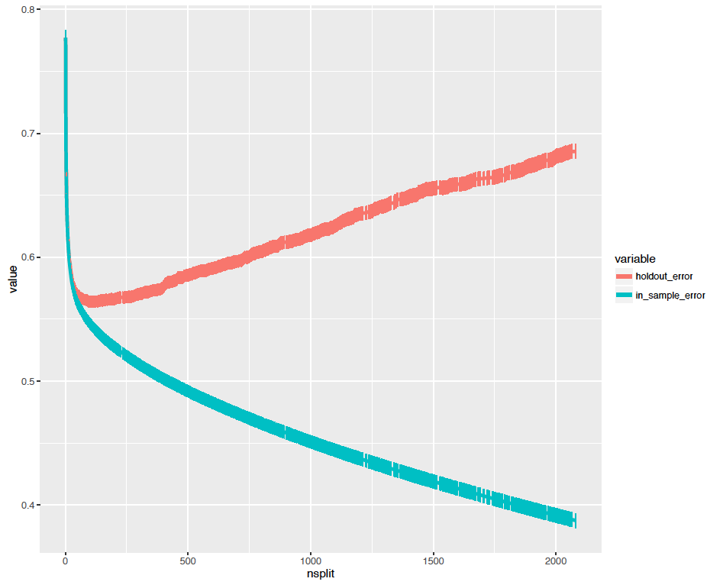
Overfit
Dominates

Slide 36
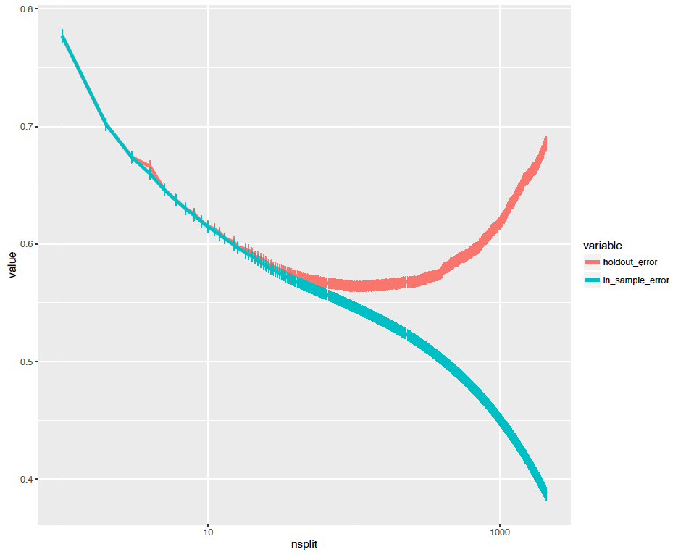
Why are we tuning on number of splits?

Slide 37
Questions and Observations
How do we choose hold-out set size?
How to choose the # of folds?
What to tune on? (regularizer)

Slide 38
What are these standard errors?

Slide 39
Questions and Observations
How do we choose hold-out set size?
How to choose the # of folds?
What to tune on? (regularizer)
Which tuning parameter to choose from cross-validation?

Slide 40
Tuning Parameter Choice
Minimum?
One standard error “rule” (rule of thumb)
Which direction?

Slide 41
Output
Which of these many trees do we output?
Even after choosing lambda we have as many trees as folds…
Estimate one tree on full data using chosen cut size
Key point: Cross validation is just for choosing tuning parameter
Just for deciding how complex a model to choose

Slide 42
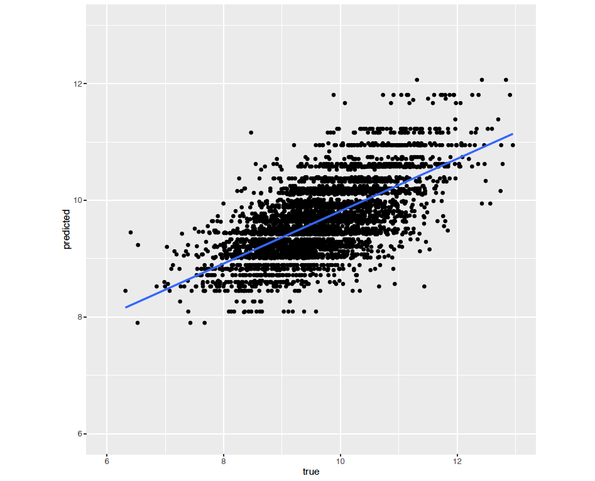
Lets look at the predictions
Notice something?

Slide 43
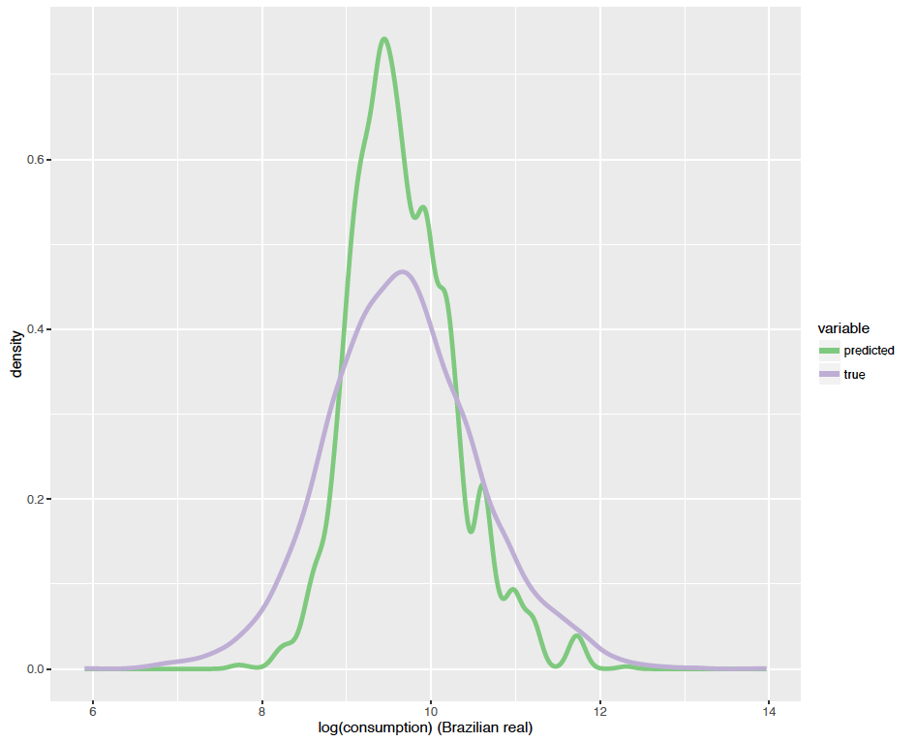
WHY?

Slide 44
What does the tree look like?

Slide 45
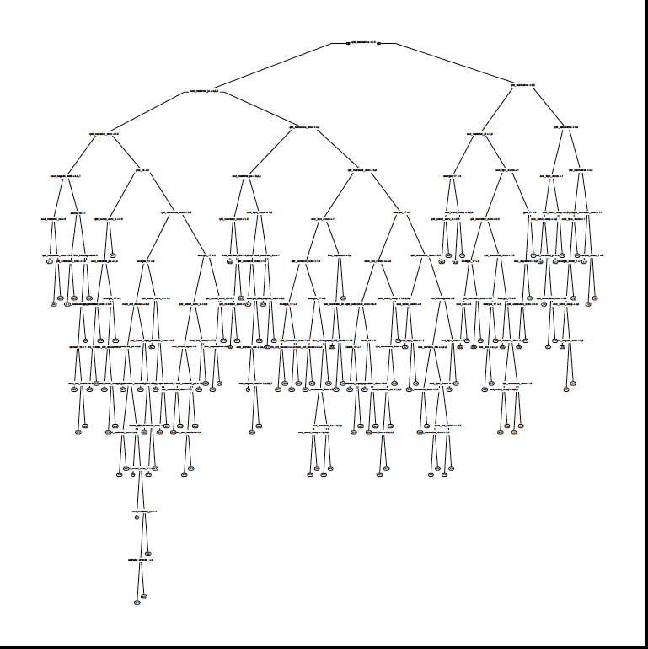

Slide 46
What else can we look at to get a sense of what the predictions are?

Slide 47
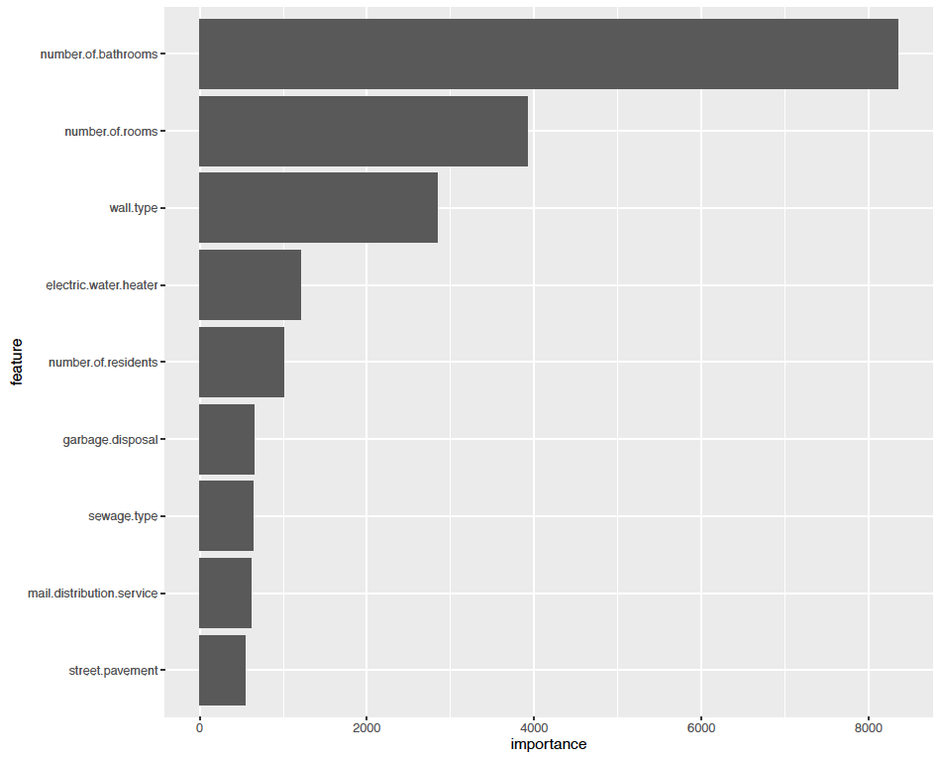
Variable Importance
Empirical loss by noising up x minus Empirical loss

Slide 48
How to describe model
Large discussion of “interpretability”
Will return to this
Should produce the mean attributes of observations in each leaf, rather than interpret tree structure
But one implication is that the prediction function itself becomes a new outcome variable to analyze.
Is any of this stable? What would a confidence interval look like?

Slide 49
Questions and Observations
How do we choose hold-out set size?
How to choose the # of folds?
What to tune on? (regularizer)
Which tuning parameter to choose from cross-validation?
What is stable/robust about the estimated function?

Slide 50
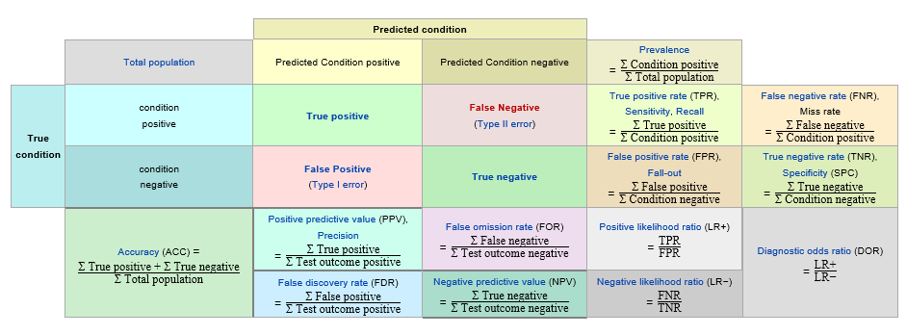
Measuring Performance

Slide 51
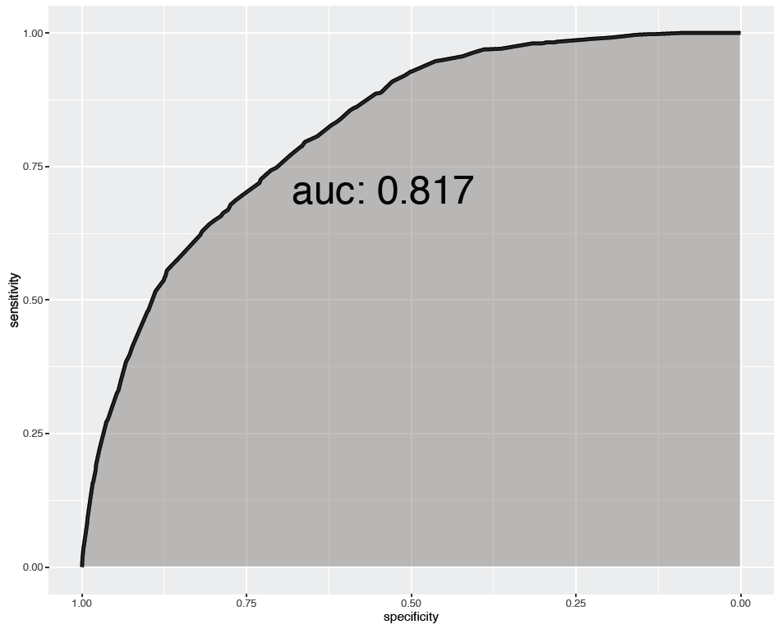

Slide 52
Measuring Performance
Area Under Curve: Typical measure of performance
What do you think of this measure?

Slide 53
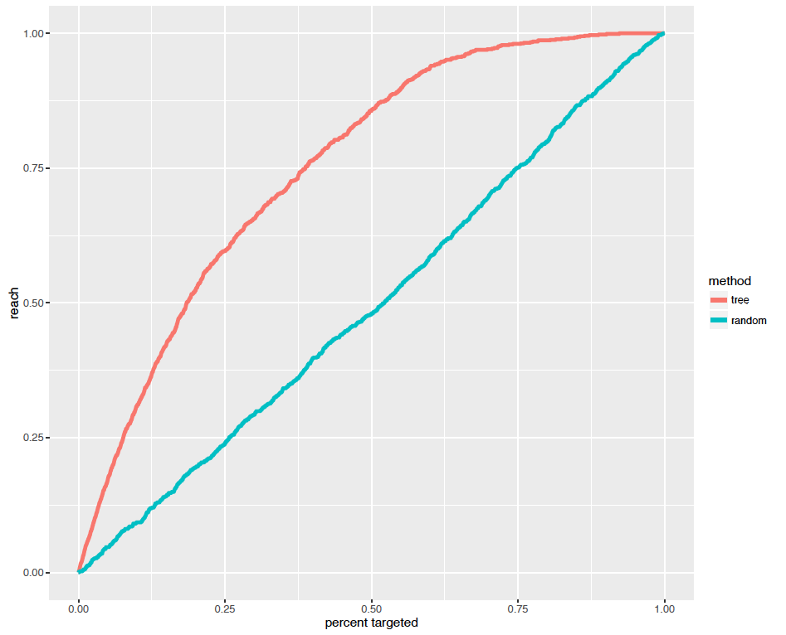
What fraction
of the poor
do we reach?

Slide 54
Measuring Performance
AUC: Typical measure of performance
What do you think of this measure?
Getting the domain specific meaningful performance measure
Magnitudes
Need point of comparison

Slide 55
What fraction
of the poor
do we reach?
Confidence
Intervals?

Slide 56
This is what we want from econometric theorems
How do we choose hold-out set size?
How to choose the # of folds?
What to tune on? (regularizer)
Which tuning parameter to choose from cross-validation?
What is stable/robust about the estimated function?
How do we form standard errors on performance?

Slide 57
Summary
Regression trees easy to understand and interpret
DON’T MISINTERPRET
Just because tree doesn’t split (LASSO doesn’t select), does not mean that a variable is not important
Consider the characteristics of the subgroup
Tradeoff between personalized versus inaccurate predictions
Cross-validation is a tool to figure out the best balance in a particular dataset
E.g if truth is complex, may want to go deeper
CART is ad hoc, but works well in practice
Loses to OLS/logit if true model is linear
Good at finding lots of complex interactions

Slide 58
Causal Trees: Recursive Partitioning for Heterogeneous Causal Effects

Slide 59
Motivation I: Experiments and Data-Mining
Concerns about ex-post “data-mining”
In medicine, scholars required to pre-specify analysis plan
In economic field experiments, calls for similar protocols
But how is researcher to predict all forms of heterogeneity in an environment with many covariates?
Goal:
Allow researcher to specify set of potential covariates
Data-driven search for heterogeneity in causal effects with valid standard errors

Slide 60
Motivation II: Treatment Effect Heterogeneity for Policy
Estimate of treatment effect heterogeneity needed for optimal decision-making
This paper focuses on estimating treatment effect as function of attributes directly, not optimized for choosing optimal policy in a given setting
This “structural” function can be used in future decision-making by policy-makers without the need for customized analysis

Slide 61
Preview
Distinguish between causal effects and attributes
Estimate treatment effect heterogeneity:
Introduce estimation approaches that combine ML prediction & causal inference tools
Introduce and analyze new cross-validation approaches for causal inference
Inference on estimated treatment effects in subpopulations
Enabling post-experiment data-mining
NOTE: estimation versus prediction objective

Slide 62
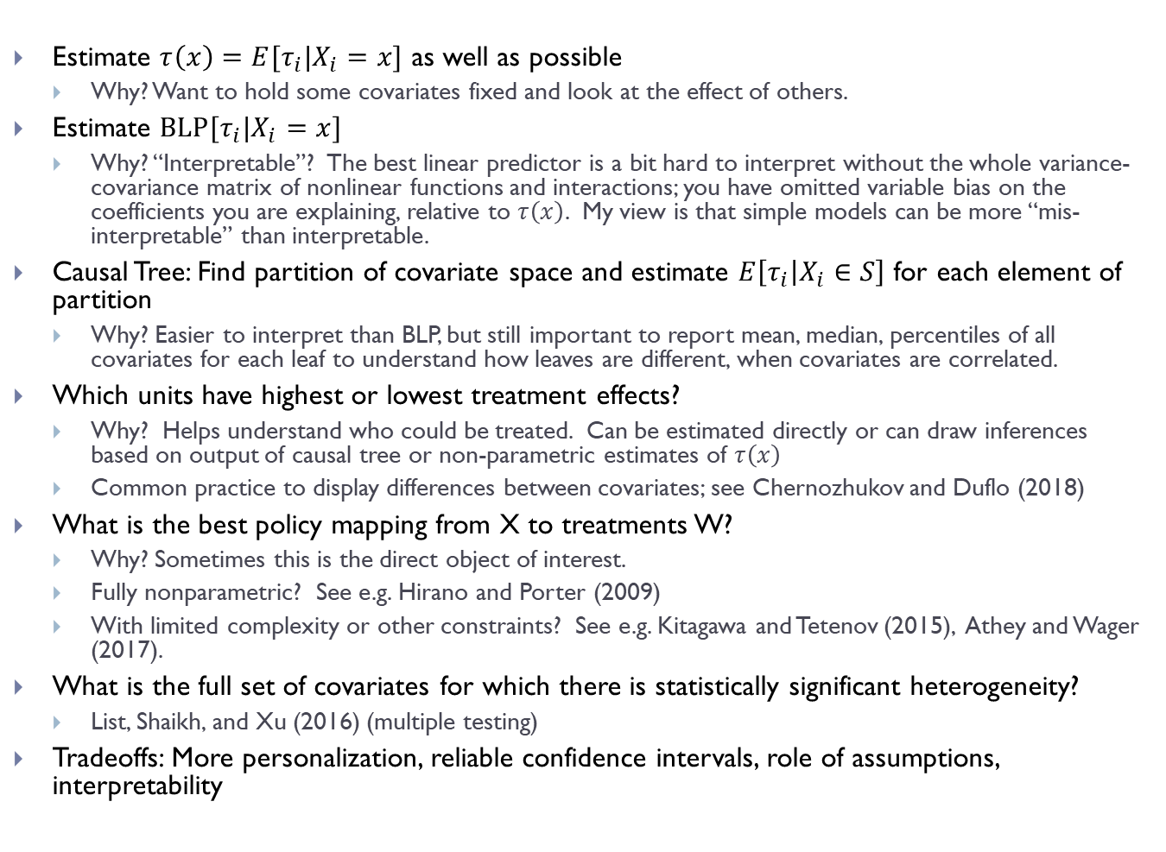
“Moving the Goalpost”: What is Question?
Estimate $τ\left(x\right)=E[τ_{i}|X_{i}=x]$ as well as possible
Why? Want to hold some covariates fixed and look at the effect of others.
Estimate $BLP[τ_{i}|X_{i}=x]$
Why? “Interpretable”? The best linear predictor is a bit hard to interpret without the whole variance-covariance matrix of nonlinear functions and interactions; you have omitted variable bias on the coefficients you are explaining, relative to $τ\left(x\right)$. My view is that simple models can be more “mis-interpretable” than interpretable.
Causal Tree: Find partition of covariate space and estimate $E\left[τ_{i} | X_{i}∈S\right]$ for each element of partition
Why? Easier to interpret than BLP, but still important to report mean, median, percentiles of all covariates for each leaf to understand how leaves are different, when covariates are correlated.
Which units have highest or lowest treatment effects?
Why? Helps understand who could be treated. Can be estimated directly or can draw inferences based on output of causal tree or non-parametric estimates of $τ\left(x\right)$
Common practice to display differences between covariates; see Chernozhukov and Duflo (2018)
What is the best policy mapping from X to treatments W?
Why? Sometimes this is the direct object of interest.
Fully nonparametric? See e.g. Hirano and Porter (2009)
With limited complexity or other constraints? See e.g. Kitagawa and Tetenov (2015), Athey and Wager (2017).
What is the full set of covariates for which there is statistically significant heterogeneity?
List, Shaikh, and Xu (2016) (multiple testing)
Tradeoffs: More personalization, reliable confidence intervals, role of assumptions, interpretability

Slide 63
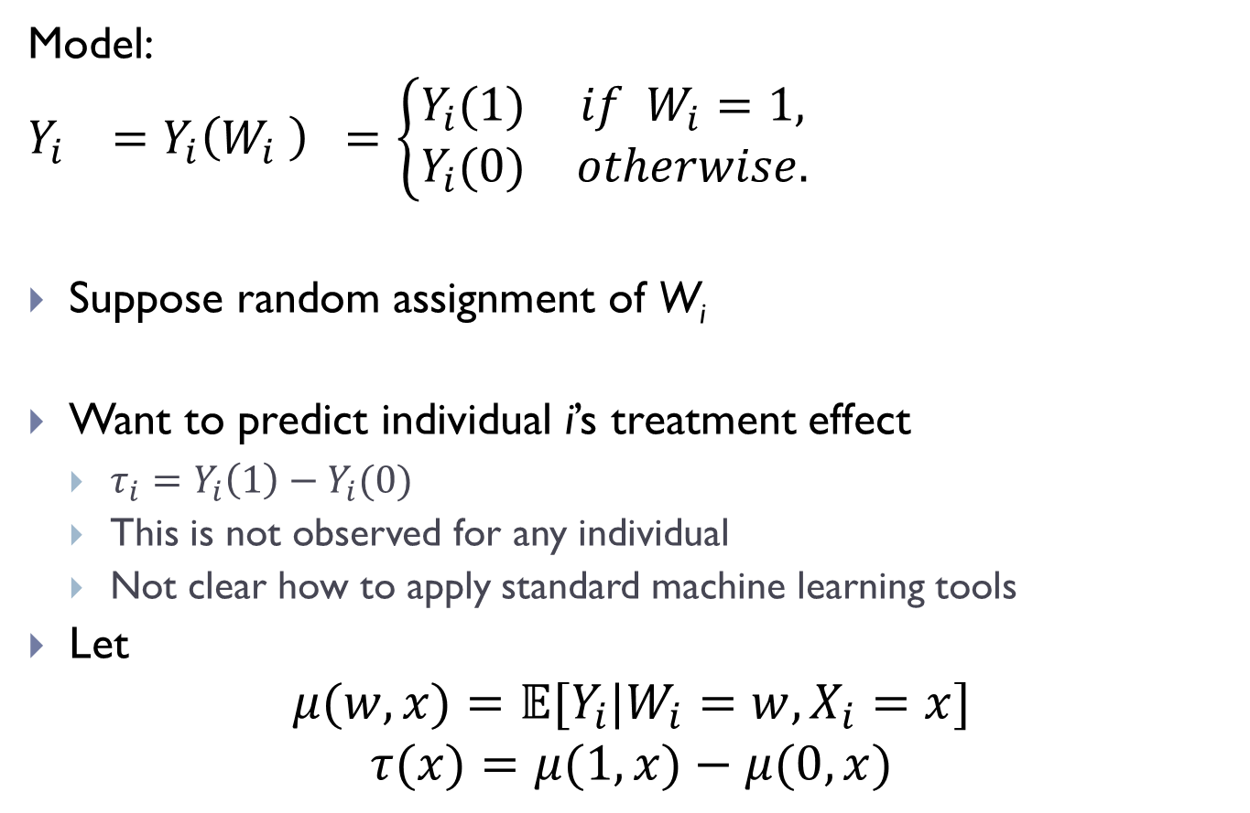
Using Trees to Estimate Causal Effects
Model:
$$Y_{i} =Y_{i}\left(W_{i} \right) =\left\{\begin{matrix}Y_{i}(1) & if W_{i}=1, \\ Y_{i}(0) & otherwise.\end{matrix}\right.$$
Suppose random assignment of W_{i}
Want to predict individual i’s treatment effect
$τ_{i}=Y_{i}\left(1\right)−Y_{i}(0)$
This is not observed for any individual
Not clear how to apply standard machine learning tools
Let
$$μ(w,x)=𝔼[Y_{i}|W_{i}=w,X_{i}=x]$$
$$τ(x)=μ(1,x)−μ(0,x)$$

Slide 64
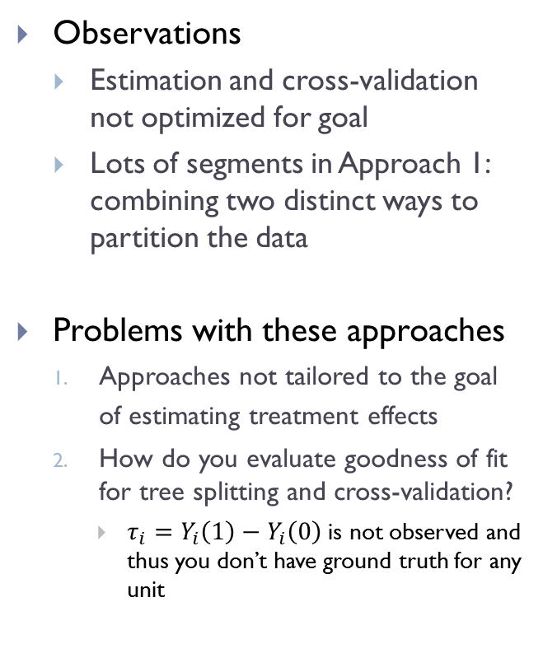
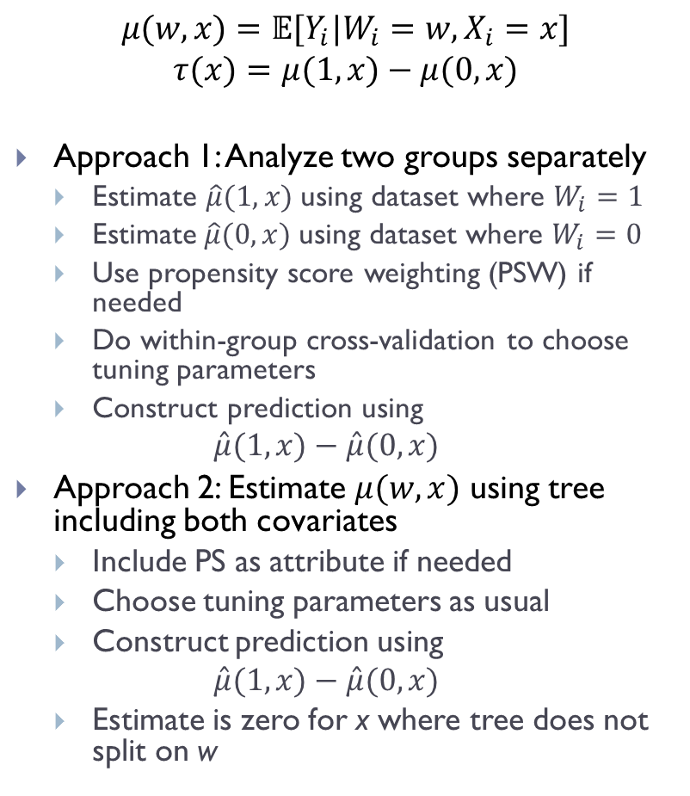
Using Trees to Estimate Causal Effects
$$μ(w,x)=𝔼[Y_{i}|W_{i}=w,X_{i}=x]$$
$$τ(x)=μ(1,x)−μ(0,x)$$
Approach 1: Analyze two groups separately
Estimate $\hat{μ}(1,x)$using dataset where $W_{i}=1$
Estimate$\hat{μ}(0,x)$using dataset where $W_{i}=0$
Use propensity score weighting (PSW) if needed
Do within-group cross-validation to choose tuning parameters
Construct prediction using
$$\hat{μ}(1,x)−\hat{μ}(0,x)$$
Approach 2: Estimate $μ(w,x)$ using tree including both covariates
Include PS as attribute if needed
Choose tuning parameters as usual
Construct prediction using
$$\hat{μ}(1,x)−\hat{μ}(0,x)$$
Estimate is zero for x where tree does not split on w
Observations
Estimation and cross-validation not optimized for goal
Lots of segments in Approach 1: combining two distinct ways to partition the data
Problems with these approaches
Approaches not tailored to the goal of estimating treatment effects
How do you evaluate goodness of fit for tree splitting and cross-validation?
$τ_{i}=Y_{i}\left(1\right)−Y_{i}\left(0\right)$ is not observed and thus you don’t have ground truth for any unit

Slide 65
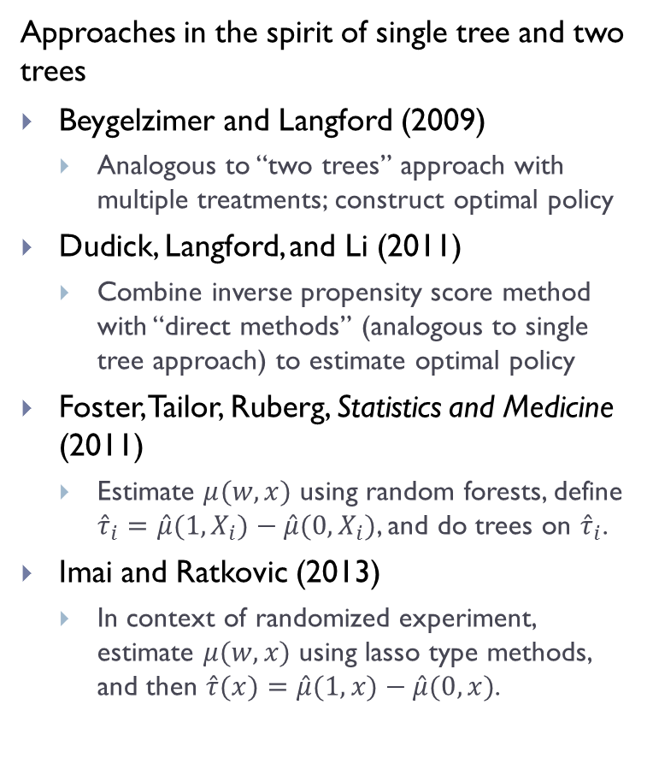
Literature
Estimating treatment effects directly at leaves of trees
Su, Tsai, Wang, Nickerson, Li (2009)
Do regular tree, but split if the t-stat for the treatment effect difference is large, rather than when the change in prediction error is large.
Zeileis, Hothorn, and Hornick (2005)
“Model-based recursive partitioning”: estimate a model at the leaves of a tree. In-sample splits based on prediction error, do not focus on out of sample cross-validation for tuning.
Transformed outcomes or covariates for regressions
Tibshirani et al (2014)
Weisberg and Pontes (2015)
Approaches in the spirit of single tree and two trees
Beygelzimer and Langford (2009)
Analogous to “two trees” approach with multiple treatments; construct optimal policy
Dudick, Langford, and Li (2011)
Combine inverse propensity score method with “direct methods” (analogous to single tree approach) to estimate optimal policy
Foster, Tailor, Ruberg, Statistics and Medicine (2011)
Estimate $μ(w,x)$ using random forests, define ${\hat{τ}}_{i}=\hat{μ}(1,X_{i})−\hat{μ}(0,X_{i})$, and do trees on ${\hat{τ}}_{i}$.
Imai and Ratkovic (2013)
In context of randomized experiment, estimate $μ(w,x)$ using lasso type methods, and then $\hat{τ}(x)=\hat{μ}(1,x)−\hat{μ}(0,x)$.

Slide 66
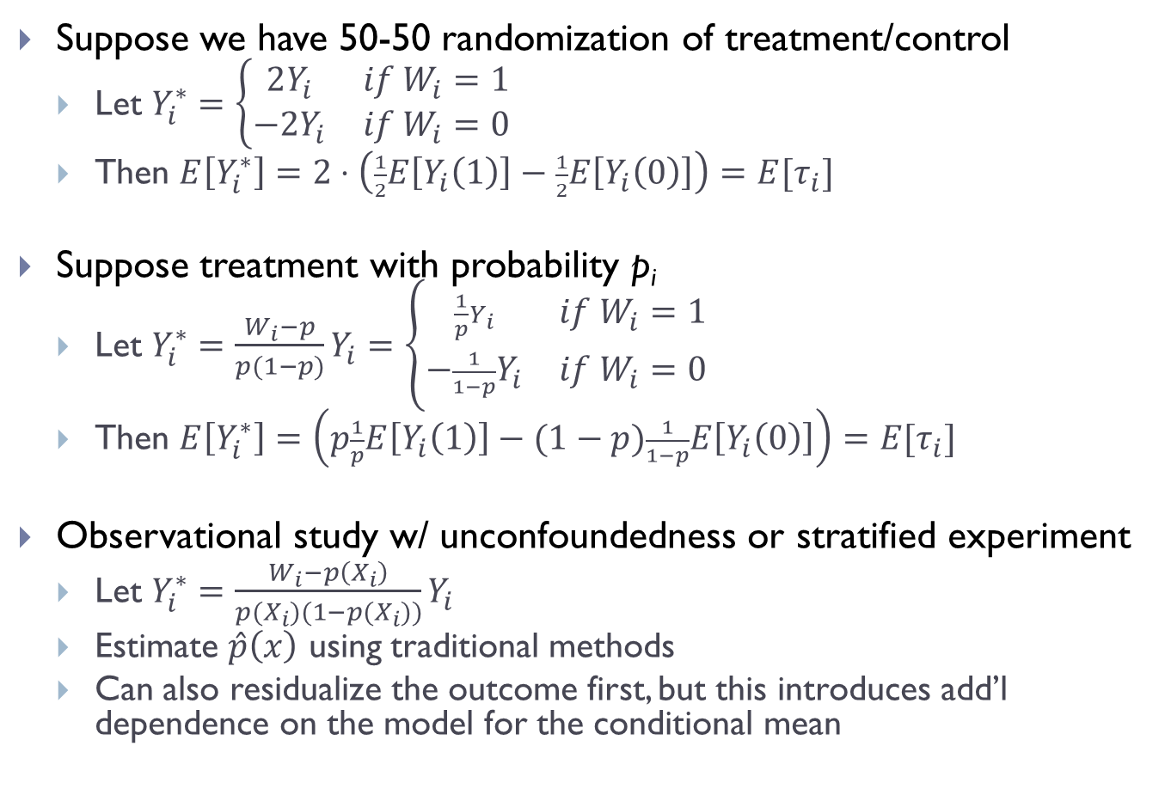
Another Approach: Transform the Outcome
Suppose we have 50-50 randomization of treatment/control
Let $Y_{i}^{∗}=\left\{\begin{matrix}2Y_{i} & if W_{i}=1 \\ −2Y_{i} & if W_{i}=0\end{matrix}\right.$
Then $E\left[Y_{i}^{∗}\right]=2⋅\left(\frac{1}{2}E\left[Y_{i}\left(1\right)\right]−\frac{1}{2}E\left[Y_{i}\left(0\right)\right]\right)=E[τ_{i}]$
Suppose treatment with probability p_{i}
Let $Y_{i}^{∗}=\frac{W_{i}−p}{p(1−p)}Y_{i}=\left\{\begin{matrix}\frac{1}{p}Y_{i} & if W_{i}=1 \\ −\frac{1}{1−p}Y_{i} & if W_{i}=0\end{matrix}\right.$
Then $E\left[Y_{i}^{∗}\right]=\left(p\frac{1}{p}E\left[Y_{i}\left(1\right)\right]−(1−p)\frac{1}{1−p}E\left[Y_{i}\left(0\right)\right]\right)=E[τ_{i}]$
Observational study w/ unconfoundedness or stratified experiment
Let $Y_{i}^{∗}=\frac{W_{i}−p\left(X_{i}\right)}{p(X_{i})(1−p(X_{i}))}Y_{i}$
Estimate $\hat{p}\left(x\right)$ using traditional methods
Can also residualize the outcome first, but this introduces add’l dependence on the model for the conditional mean

Slide 67
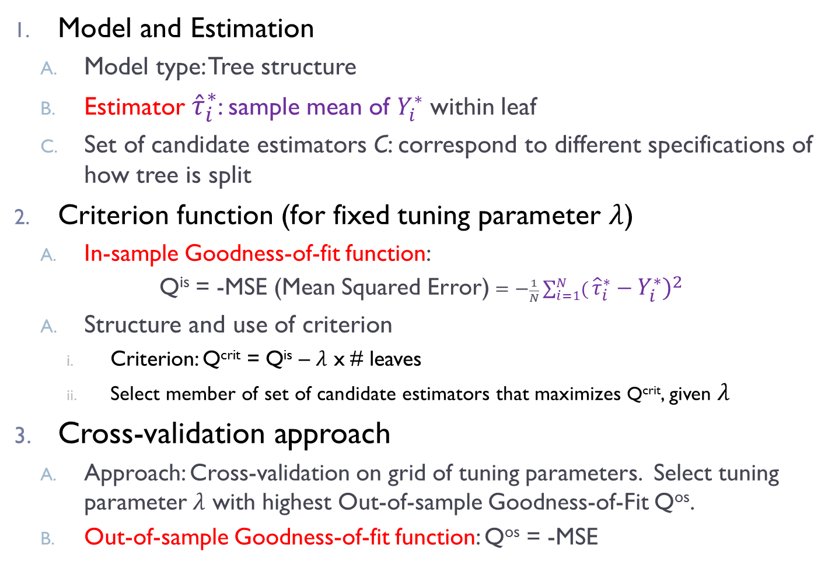
Causal Trees: (Conventional Tree, Transformed Outcome)
Model and Estimation
Model type: Tree structure
Estimator ${\hat{τ}}_{i}^{∗}$: sample mean of $Y_{i}^{∗}$ within leaf
Set of candidate estimators C: correspond to different specifications of how tree is split
Criterion function (for fixed tuning parameter $λ$)
In-sample Goodness-of-fit function:
Q^{is} = -MSE (Mean Squared Error) $=−\frac{1}{N}\sum_{i=1}^{N}{(}{\hat{τ}}_{i}^{∗}−Y_{i}^{∗})^{2}$
Structure and use of criterion
Criterion: Q^{crit} = Q^{is} – $λ$ x # leaves
Select member of set of candidate estimators that maximizes Q^{crit}, given $λ$
Cross-validation approach
Approach: Cross-validation on grid of tuning parameters. Select tuning parameter $λ$ with highest Out-of-sample Goodness-of-Fit Q^{os}.
Out-of-sample Goodness-of-fit function: Q^{os} = -MSE

Slide 68
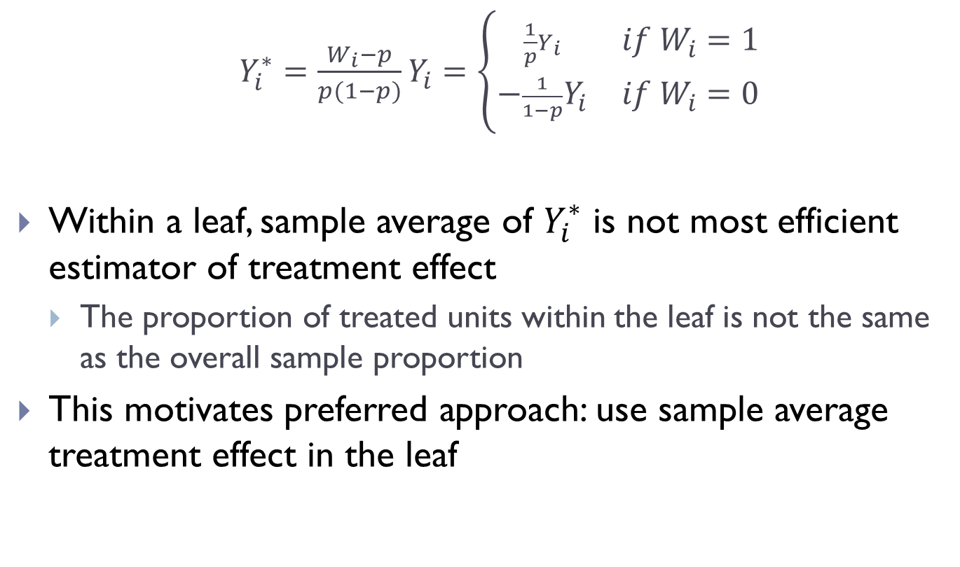
Critique of Approach: Transform the Outcome
$Y_{i}^{∗}=\frac{W_{i}−p}{p(1−p)}Y_{i}=\left\{\begin{matrix}\frac{1}{p}Y_{i} & if W_{i}=1 \\ −\frac{1}{1−p}Y_{i} & if W_{i}=0\end{matrix}\right.$
Within a leaf, sample average of $Y_{i}^{∗}$ is not most efficient estimator of treatment effect
The proportion of treated units within the leaf is not the same as the overall sample proportion
This motivates preferred approach: use sample average treatment effect in the leaf

Slide 69
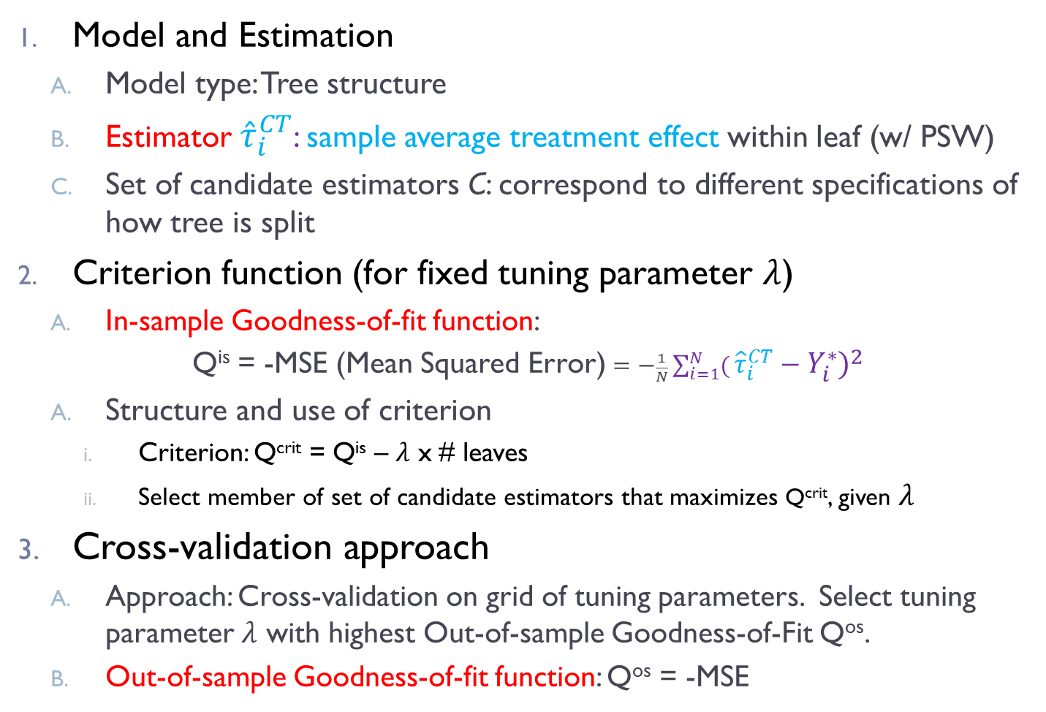
Causal Trees: (Causal Tree, TOT loss function)
Model and Estimation
Model type: Tree structure
Estimator ${\hat{τ}}_{i}^{CT}$: sample average treatment effect within leaf (w/ PSW)
Set of candidate estimators C: correspond to different specifications of how tree is split
Criterion function (for fixed tuning parameter $λ$)
In-sample Goodness-of-fit function:
Q^{is} = -MSE (Mean Squared Error) $=−\frac{1}{N}\sum_{i=1}^{N}{(}{\hat{τ}}_{i}^{CT}−Y_{i}^{∗})^{2}$
Structure and use of criterion
Criterion: Q^{crit} = Q^{is} – $λ$ x # leaves
Select member of set of candidate estimators that maximizes Q^{crit}, given $λ$
Cross-validation approach
Approach: Cross-validation on grid of tuning parameters. Select tuning parameter $λ$ with highest Out-of-sample Goodness-of-Fit Q^{os}.
Out-of-sample Goodness-of-fit function: Q^{os} = -MSE

Slide 70
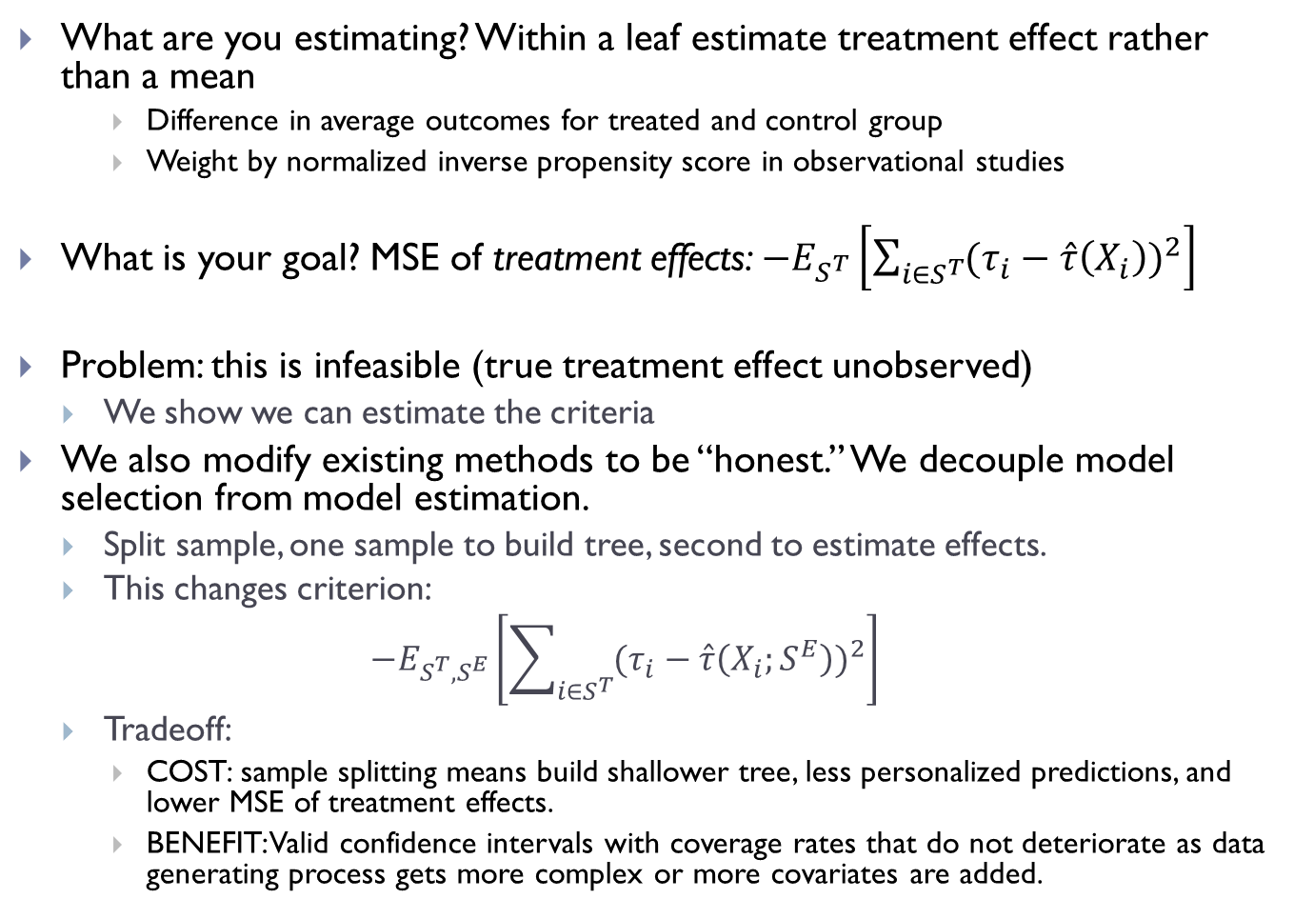
Causal Trees
What are you estimating? Within a leaf estimate treatment effect rather than a mean
Difference in average outcomes for treated and control group
Weight by normalized inverse propensity score in observational studies
What is your goal? MSE of treatment effects: $−E_{S^{T}}\left[\sum_{i∈S^{T}}{{(τ_{i}−\hat{τ}\left(X_{i}\right))}^{2}}\right]$
Problem: this is infeasible (true treatment effect unobserved)
We show we can estimate the criteria
We also modify existing methods to be “honest.” We decouple model selection from model estimation.
Split sample, one sample to build tree, second to estimate effects.
This changes criterion:
$$−E_{S^{T},S^{E}}\left[\sum_{i∈S^{T}}{{(τ_{i}−\hat{τ}\left(X_{i};S^{E}\right))}^{2}}\right]$$
Tradeoff:
COST: sample splitting means build shallower tree, less personalized predictions, and lower MSE of treatment effects.
BENEFIT: Valid confidence intervals with coverage rates that do not deteriorate as data generating process gets more complex or more covariates are added.
Notes:
Causal trees: estimate average treatment effect within leaves as difference in average outcomes by treatment status (more efficient than average of transformed outcome)
would like to minimize sum(tau_i-hat_tau_i)^2, but not feasible, replace this infeasible target by unbiased estimate

Slide 71
Honest Causal Trees
Honest estimation changes expected criterion
Criterion anticipates that we will re-estimate effects in the leaves.
The bias due to “dishonest” selection of tree structure will be eliminated.
Eliminating the bias was the main purpose of cross-validation in standard method.
We face uncertainty in what honest sample will estimate
Small leaves will create noise.
Splitting on variables that don’t affect treatment effect can reduce variance
Criterion for splitting and cross-validation changes
Given set of leaves, MSE on test set taking into account re-estimation.
Uncertainty over estimation set and test set at time of evaluation.
Notes:
Causal trees: estimate average treatment effect within leaves as difference in average outcomes by treatment status (more efficient than average of transformed outcome)
would like to minimize sum(tau_i-hat_tau_i)^2, but not feasible, replace this infeasible target by unbiased estimate

Slide 72
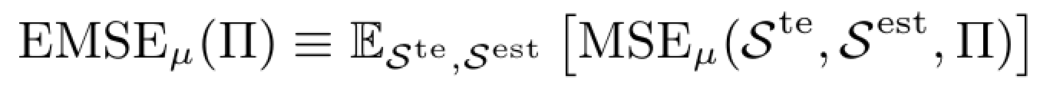
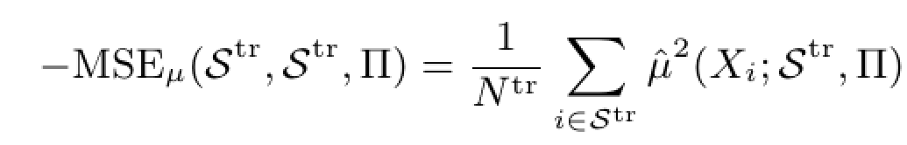
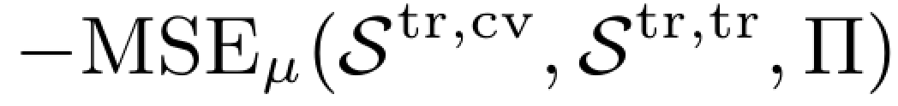
Standard Prediction Trees
Conventional CART uses for training and CV, respectively:
$$=\frac{1}{N^{tr,cv}}\sum_{i∈𝒮^{tr,cv}}{\left((\hat{μ}{\left(X_{i};𝒮^{tr,tr}\right))}^{2}−2\hat{μ}(X_{i};𝒮^{tr,cv})\hat{μ}(X_{i};𝒮^{tr,tr})\right)}$$
Notes:
Causal trees: estimate average treatment effect within leaves as difference in average outcomes by treatment status (more efficient than average of transformed outcome)
would like to minimize sum(tau_i-hat_tau_i)^2, but not feasible, replace this infeasible target by unbiased estimate

Slide 73
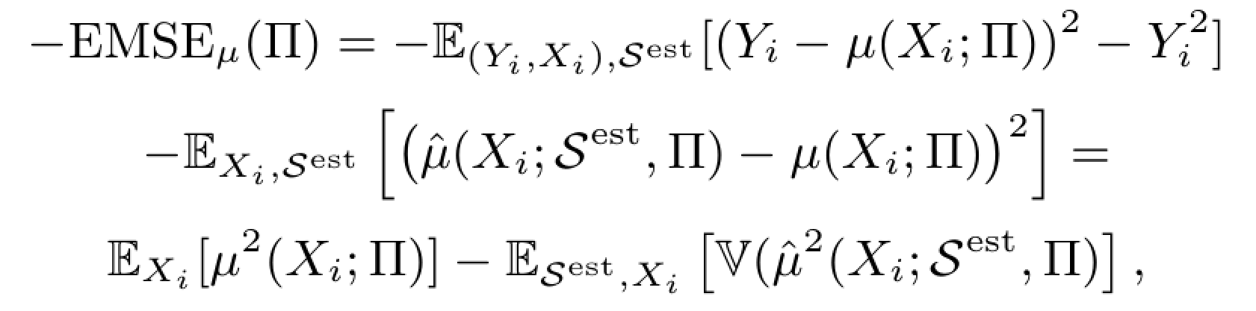
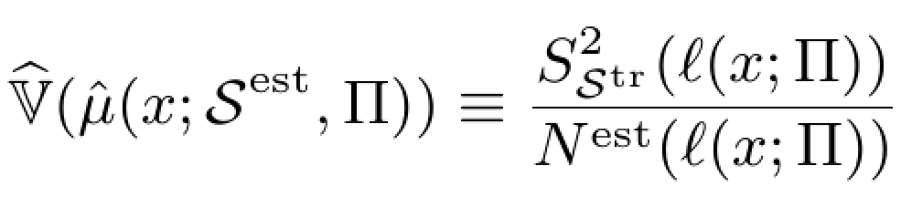
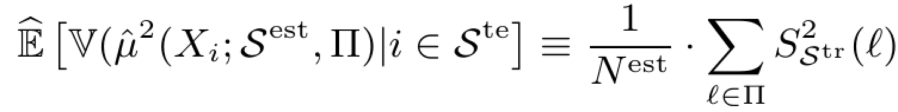
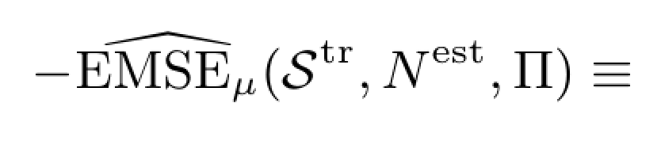

Honest Prediction Trees
This uses fact that estimator on independent sample is unbiased
Notes:
Causal trees: estimate average treatment effect within leaves as difference in average outcomes by treatment status (more efficient than average of transformed outcome)
would like to minimize sum(tau_i-hat_tau_i)^2, but not feasible, replace this infeasible target by unbiased estimate

Slide 74





Standard Causal Trees
For training and CV, respectively:
Notes:
Causal trees: estimate average treatment effect within leaves as difference in average outcomes by treatment status (more efficient than average of transformed outcome)
would like to minimize sum(tau_i-hat_tau_i)^2, but not feasible, replace this infeasible target by unbiased estimate

Slide 75


Honest Causal Trees
This uses fact that estimator on independent sample is unbiased
For training and CV, respectively:
Notes:
Causal trees: estimate average treatment effect within leaves as difference in average outcomes by treatment status (more efficient than average of transformed outcome)
would like to minimize sum(tau_i-hat_tau_i)^2, but not feasible, replace this infeasible target by unbiased estimate

Slide 76
Inference
Attractive feature of trees:
Can easily separate tree construction from treatment effect estimation
Tree constructed on training sample is indep. of sampling variation in test sample
Holding tree from training sample fixed, can use standard methods to conduct inference within each leaf of the tree on test sample
Use any valid method for treatment effect estimation, not just method used in training. Asymptotic theory as usual within a leaf.
Once you have the partition, just run a regression on second sample interacting leaf dummies with treatment indicator. Everything is as usual.
We do not require ANY assumptions about sparsity of true data-generating process. Coverage does not deteriorate at all as you increase number of covariates.
But we do not attempt to make fully personalized estimates

Slide 77
Comparing Alternative Approaches to Preferred Honest Causal Tree
Dishonest with double the sample
Does worse if true model is sparse (also the case where bias is less severe)
Has similar or better MSE in many cases, but poor coverage of confidence intervals
Splitting on statistical criteria of model fit
Paper shows formally how these methods differ (proposed in a small related literature, one that doesn’t consider honesty and cross-validation issues)
Splitting on T-statistic on treatment effect ignores variance reduction from reducing imbalance on covariates
Splitting on overall model fit prioritizes level heterogeneity above treatment effects

Slide 78
Application: Treatment Effect Heterogeneity in Estimating Position Effects in Search
Queries highly heterogeneous
Tens of millions of unique search phrases each month
Query mix changes month to month for a variety of reasons
Behavior conditional on query is fairly stable
Desire for segments.
Want to understand heterogeneity and make decisions based on it
“Tune” algorithms separately by segment
Want to predict outcomes if query mix changes
For example, bring on new syndication partner with more queries of a certain type

Slide 79
Relevance v. Position

Slide 80

Search Experiment Tree: Effect of Demoting Top Link (Test Sample Effects)
Some data excluded with prob p(x): proportions do not match population
Highly navigational queries excluded

Slide 81


Slide 82
Use Test Sample for Segment Means & Std Errors to Avoid Bias Variance of estimated treatment effects in training sample 2.5 times that in test sample (adaptive estimates biased)
Honest Estimates |  |  | Adaptive Estimates
Treatment Effect | Standard Error | Proportion | Treatment Effect | Standard Error | Proportion
-0.124 | 0.004 | 0.202 | -0.124 | 0.004 | 0.202
-0.134 | 0.010 | 0.025 | -0.135 | 0.010 | 0.024
-0.010 | 0.004 | 0.013 | -0.007 | 0.004 | 0.013
-0.215 | 0.013 | 0.021 | -0.247 | 0.013 | 0.022
-0.145 | 0.003 | 0.305 | -0.148 | 0.003 | 0.304
-0.111 | 0.006 | 0.063 | -0.110 | 0.006 | 0.064
-0.230 | 0.028 | 0.004 | -0.268 | 0.028 | 0.004
-0.058 | 0.010 | 0.017 | -0.032 | 0.010 | 0.017
-0.087 | 0.031 | 0.003 | -0.056 | 0.029 | 0.003
-0.151 | 0.005 | 0.119 | -0.169 | 0.005 | 0.119
-0.174 | 0.024 | 0.005 | -0.168 | 0.024 | 0.005
0.026 | 0.127 | 0.000 | 0.286 | 0.124 | 0.000
-0.030 | 0.026 | 0.002 | -0.009 | 0.025 | 0.002
-0.135 | 0.014 | 0.011 | -0.114 | 0.015 | 0.010
-0.159 | 0.055 | 0.001 | -0.143 | 0.053 | 0.001
-0.014 | 0.026 | 0.001 | 0.008 | 0.050 | 0.000
-0.081 | 0.012 | 0.013 | -0.050 | 0.012 | 0.013
-0.045 | 0.023 | 0.001 | -0.045 | 0.021 | 0.001
-0.169 | 0.016 | 0.011 | -0.200 | 0.016 | 0.011
-0.207 | 0.030 | 0.003 | -0.279 | 0.031 | 0.003
-0.096 | 0.011 | 0.023 | -0.083 | 0.011 | 0.022
-0.096 | 0.005 | 0.069 | -0.096 | 0.005 | 0.070
-0.139 | 0.013 | 0.013 | -0.159 | 0.013 | 0.013
-0.131 | 0.006 | 0.078 | -0.128 | 0.006 | 0.078

Slide 83
Analyzing Field Experiments: Revisit Karlan and List (AER)
Field experiment on charitable giving
Solicitations: treatment groups are offered match of various sizes, example gifts, and limits
Finding: match increases gift amount, but larger sizes do not have incremental effect
Some exploration of heterogeneity
Apply causal trees:
Explore heterogeneity more systematically
Highlight the risks of data mining
Unlike the search application, it appears there isn’t a lot of treatment effect heterogeneity

Slide 84
Effect of All Treatments (Pooled) Training Data

Slide 85
Training Sample

Slide 86
Estimation Sample

Slide 87
Interpretation: Sample Splitting is Key
Training set makes it look like there is lots of heterogeneity
Estimation sample accurately shows most of that is spurious
You get the right, if disappointing, answer out of the estimation sample

Slide 88
Summary
Key to approach
Distinguish between causal and predictive parts of model
Combining two literatures
Combining very well established tools from different literatures
Systematic model selection with many covariates
Optimized for problem of causal effects
In terms of tradeoff between granular prediction and overfitting
With valid inference
While sacrificing fully personalized predictions, but gaining…
Easy to communicate method and interpret results
Output is a partition of sample, treatment effects and standard errors

